Slide 1
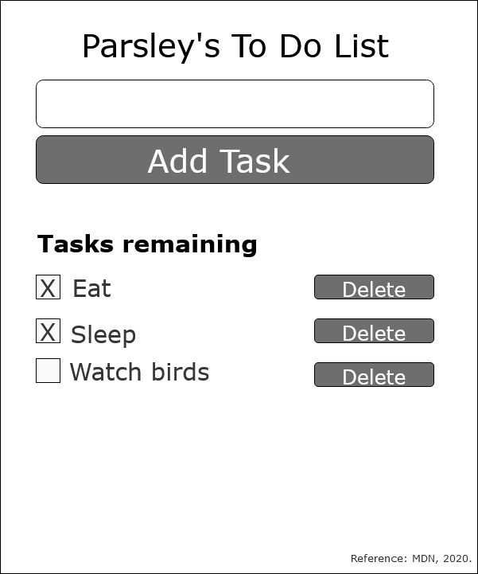
React To-Do Planning Assignment
In React, a component is a reusable module that renders a part of our app (MDN, 2020b).
A prop is any data passed into a React component (MDN, 2020b).
Props are written inside component calls, and use the same syntax as HTML attributes – prop=“value”.
Consider Parsley’s user choice (MDN, 2020b):
read a lists of tasks.
add a tasks using the mouse/keyboard.
mark any task as completed using mouse/keyboard.
delete any task using mouse/keyboard.

Slide 2
1
The Main Container of To-Do Task – This container component will show page for the user. This container include components: input task form, add task button, task list, delete buttons (Fesehatsion, 2019).
1
Input Form Component – This should allow user to input task. This contain functional components to just receive props as arguments and return JSX to be rendered. This component will only have one prop to handle the click event for adding a new to-do (Nwamba, 2016).
2
To-Do Component – This component should include <ul> that contains a loop of to-do components made of <li> (Nwamba, 2016).
To-Do List Component:
The “Delete” property is an event handler that will be called when the item is clicked. The purpose is to delete a task when it is click. This will be taken care of in the container component (Nwamba, 2016).
The only the “delete” property can be passed in to it’s to the To-Do Component via it’s parent (Nwamba 2016).
5
4
3
Completed Component – This should be a simple component to hold true or false to determine whether it has been completed or not (MDN, 2020a).

Slide 3
Initializing my To-Do app (MDN, 2020b).
Install npm packages such as npx create-react-app moz-todo-react.
Initialize npm start.
Review app.js and understand import statements, app component in the middle, export statement at the bottom.
Pre-project house keeping. Since we are not doing any styling (assume we have a design department), App.test.js App.css logo.svg serviceWorker.js setupTests.js. Additionally, we also removed the unrelated links to styles sheet and script sheet.

Slide 4
How Each Components are Linked
A visual description of a functioning To-Do application using arrows and pseudocode.

Slide 5
Step 1: The Main Container of To-Do Task (MDN, 2020b).
1
Create a skeleton App(function) and paste to the App.js that creates the:
Title: Parsley’s To Do List
Input Form: create <form> element to make a skeleton of an input form user can type.
Button: create a button type=“submit”.
Create three unordered list <ul> and <li> as shown as eat, sleep, and watch birds.
Check box is represented by <input type="checkbox" defaultChecked={true} />
Delete button is represented with a button element to remove the specific listed task.

Slide 6
Step 2: The Main Container of To-Do Task
User input task such as “eat”, “sleep”, “grooming”, etc.

Slide 7
Breakdowns (Pseudocode)

